Slide 1
Advanced Python Modules
Summer 2021
Notes:
1
1
Check distro statement before using:
DISTRIBUTION STATEMENT A. Approved for pubic release: distribution is unlimited.
This material is based upon work supported under Air Force Contract No. FA8721-05-C-0002 and/or FA8702-15-D-0001. Any opinions, findings, conclusions or recommendations expressed in this material are those of the author(s) and do not necessarily reflect the views of the U.S. Air Force.
© 2021 Massachusetts Institute of Technology.
Delivered to the U.S. Government with Unlimited Rights, as defined in DFARS Part 252.227-7013 or 7014 (Feb 2014). Notwithstanding any copyright notice, U.S. Government rights in this work are defined by DFARS 252.227-7013 or DFARS 252.227-7014 as detailed above. Use of this work other than as specifically authorized by the U.S. Government may violate any copyrights that exist in this work.

Slide 2
Overview
Numpy
Matplotlib
Pandas
Scipy
Scikit learn
Tensorflow / Keras
Pytorch

Slide 3
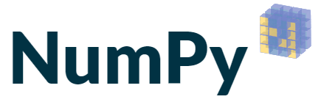
Numpy
https://numpy.org/
When to use
Staple of python, basis of many other popular packages
Focused on the ndarray datatype and operations over it
Numpy arrays must be heterogeneous data types unlike python lists
Performance improvements on array and matrix operations (vectorization)
Popular features
Array slicing and indexing
Universal functions (max, mean, power, etc…)
Broadcasting
Masking, comparing, and sorting
Vector computation

Slide 4
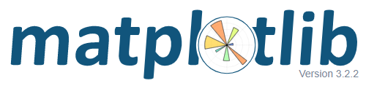
Matplotlib
https://matplotlib.org/
When to use
Basic plotting package
More fancy plotting: Seaborn, Ploty, Geoplotlib, etc…
Can create static, animated, and interactive visualizations
API mirrors other popular plotting packages (matlab)
Popular features
Multiple plots
Scatter plot with histograms
Stackplots
Timelines
Contour plots
So many more: https://matplotlib.org/gallery/index.html

Slide 5

Pandas
https://pandas.pydata.org/
When to use
Data analysis and exploration
Many built in analysis tools
Interfaces with other analysis and visualization packages as well
Data manipulation and processing
Popular features
Importing/Exporting
Exploring
Grouping
Descriptive Stats
Basic plotting, integration with plotting packages

Slide 6

Scipy
https://www.scipy.org/
When to use
Generalized package for math, science, and engineering
Before you implement your own functions, check if someone else has!
Built with and/or integrated with numpy, matplotlib, pandas, and sympy
Popular features
Interpolation
Linear Algebra
Fitting data
Differential Equations
Brownian Motion
Convex Hull of a 2-D Dataset

Slide 7
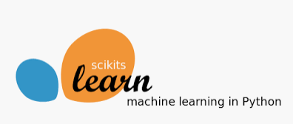
Scikit-Learn
https://scikit-learn.org/stable/
When to use
Machine learning package
Predictive data analysis
Built on Numpy, SciPy, and Matplotlib
Popular features
Classification
Regression
Clustering
Decision Tree
Gaussian Mixture Models
Support Vector Machines

Slide 8
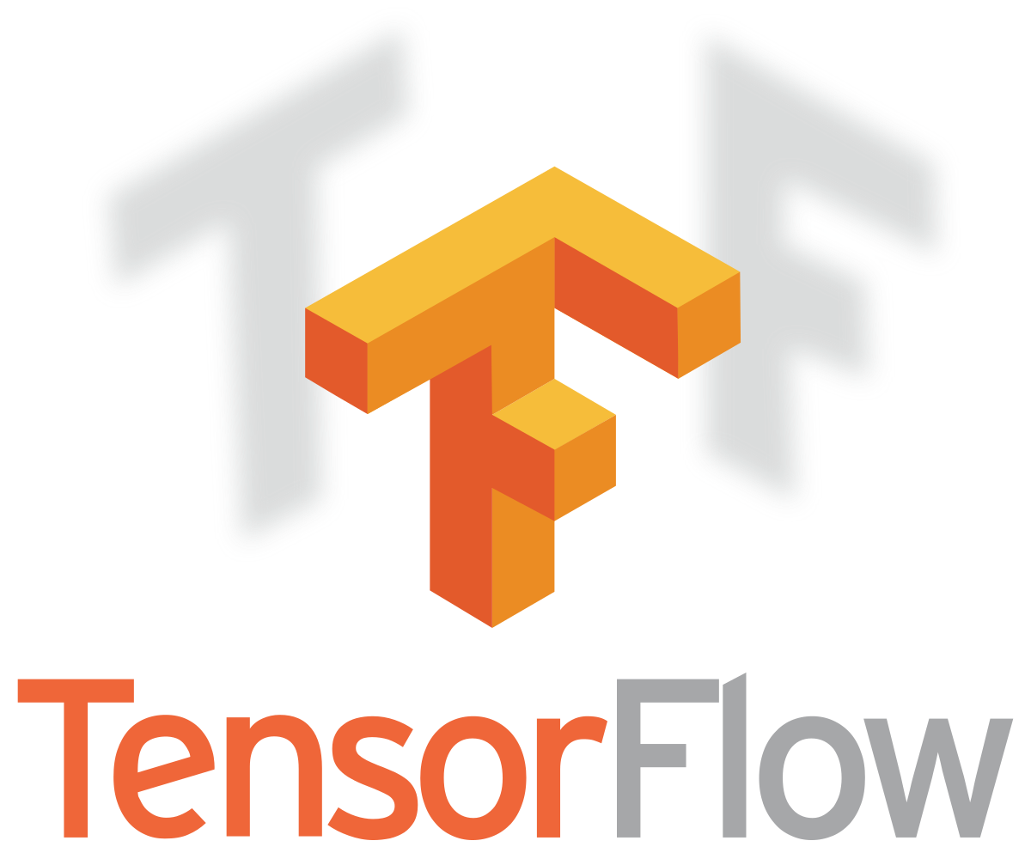
Tensorflow / Keras
https://www.tensorflow.org/api_docs/python/tf/keras
When to use
Develop, train, and deploy ML models (end-to-end open source ML)
Extends to browser (js), mobile, IoT, and production environments
TF 2.0 integrated the high level simplified API Keras
Makes TF much easier to use for most functions
Fully supported GPU computations
Popular features
Neural Networks
Generative Adversarial Networks (GANs)
Natural Language Processing (translation example)

Slide 9

Pytorch
https://pytorch.org/
When to use
Same concept as TF / Keras (different owner and maintainer)
Google vs Facebook
Dynamic computational graph (TF uses a static graph)
Makes some things like recurrent neural networks easier
Before TF 2.0, Pytorch was much easier to use
TF is better for production and has more utilities (TensorBoard)
Popular features
Neural Networks
Generative Adversarial Networks (GANs)
Long-Short Term Memory (LSTM): Dynamic Quantization

Slide 10
Examples
Swap over to notebook for examples

Slide 11


